Slide 1
Lane Direction Assist
(an ADAS concept system)
Eric Butler
20094078
Brendan Jackman
Supervisor

Slide 2
Agenda
Introduction
Motive for choosing project
Background details
Functionality
Methodology
Technologies
Learning outcomes

Slide 3
Introduction
ADAS concept system to detect vehicles approach a road, junction or roundabout the incorrect way.
Detection operates ADAS. Visual and/or Physical
Built upon concept of using existing systems already legislated within the vehicle.

Slide 4
Motive for choosing project
First project idea, traffic light system too complex, Functionality differed to Automotive idea.
Show multiple skills / concepts: Coding, Automotive (Theory / Technologies), Problem solving, Project development
Answering question:
“How can we make junctions and roundabouts safer?”

Slide 5
Background Details
Advance Driver Assistance Systems ensure automation / adaptation to systems in a car in the event of an emergency.
Systems triggered: Traction, Brakes, Mirrors, Steering.
Car2x – communication between Vehicle and SMART Technology (including other Vehicles) via Cloud.
CANoe – Industry software to simulation test scenarios to optimise new systems / ideas.

Slide 6
Functionality
CANoe simulation to test proof of concept – Scenarios to simulate vehicles approaching incorrectly to trigger LED signals / ADAS systems.
Scenarios include but not limited to: Roundabout direction, One way street, incorrect lane.
ADAS systems include but not limited to: LEDs, Braking, Steering wheel vibration.
Possibility for controlled live demo in project 2.

Slide 7
Methodology
V cycle method used – Research example / concepts – Innovate and develop personal mini projects to check for purpose.
Example – 3D map render using HERE developer to allow for multipurpose functionality.
Discussion with supervisor about concept and possible complexity / before deeming viability.
Example – 3D map deemed to have too much issues, dropped.

Slide 8
Technologies
Vector CANoe (Car2x Package) – Simulation – Messages – RSUs – Nodes (vehicles)
CAPL code – Functions behind the simulation – Vehicle / RSU behaviours.
HERE Developer – 3D Map render – Built upon JavaScript.
Microsoft Project – Project Plan and task tracking
Lucid chart – ER Diagram – Visualise functionality to micro level

Slide 9
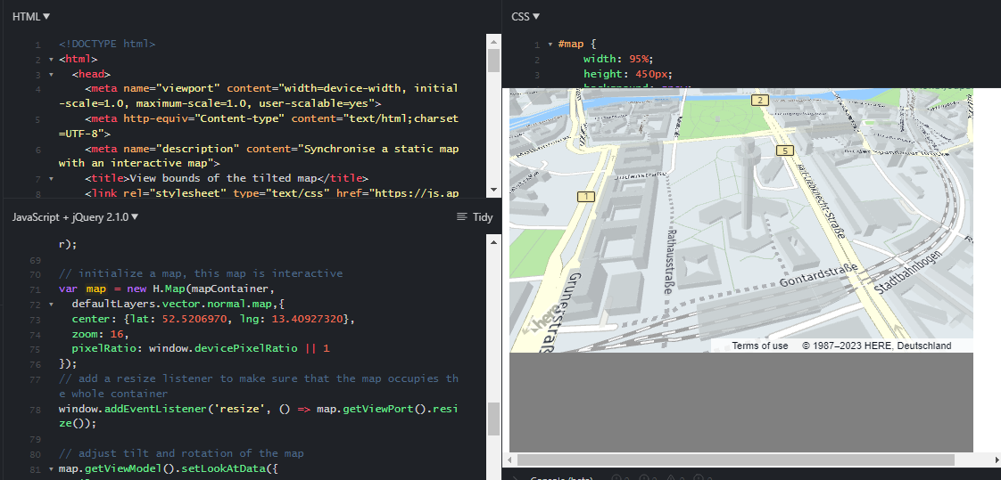
Example of HERE 3D mapping

Slide 10
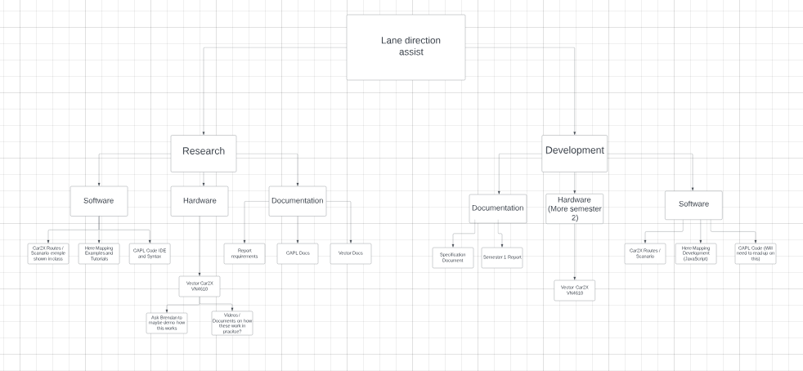
Example of ER diagram to show layout of project

Slide 11
Conclusion / Learning Outcomes
Proof of concept is possible – Verification from simulation as well as both supervisor & industry staff.
Ability to take an idea / question and turn it into a functional proof of concept.
Time management – Difficult due to learning new concepts & bug fixing can hinder time spent on functionality. Module factor.
Experimentation – Scraping ideas is okay if not viable, Research into more technologies.

Slide 12
Thank You Any Questions.

